Slide 1
Joe Spencer
ME EN 497R research presentation

Slide 2
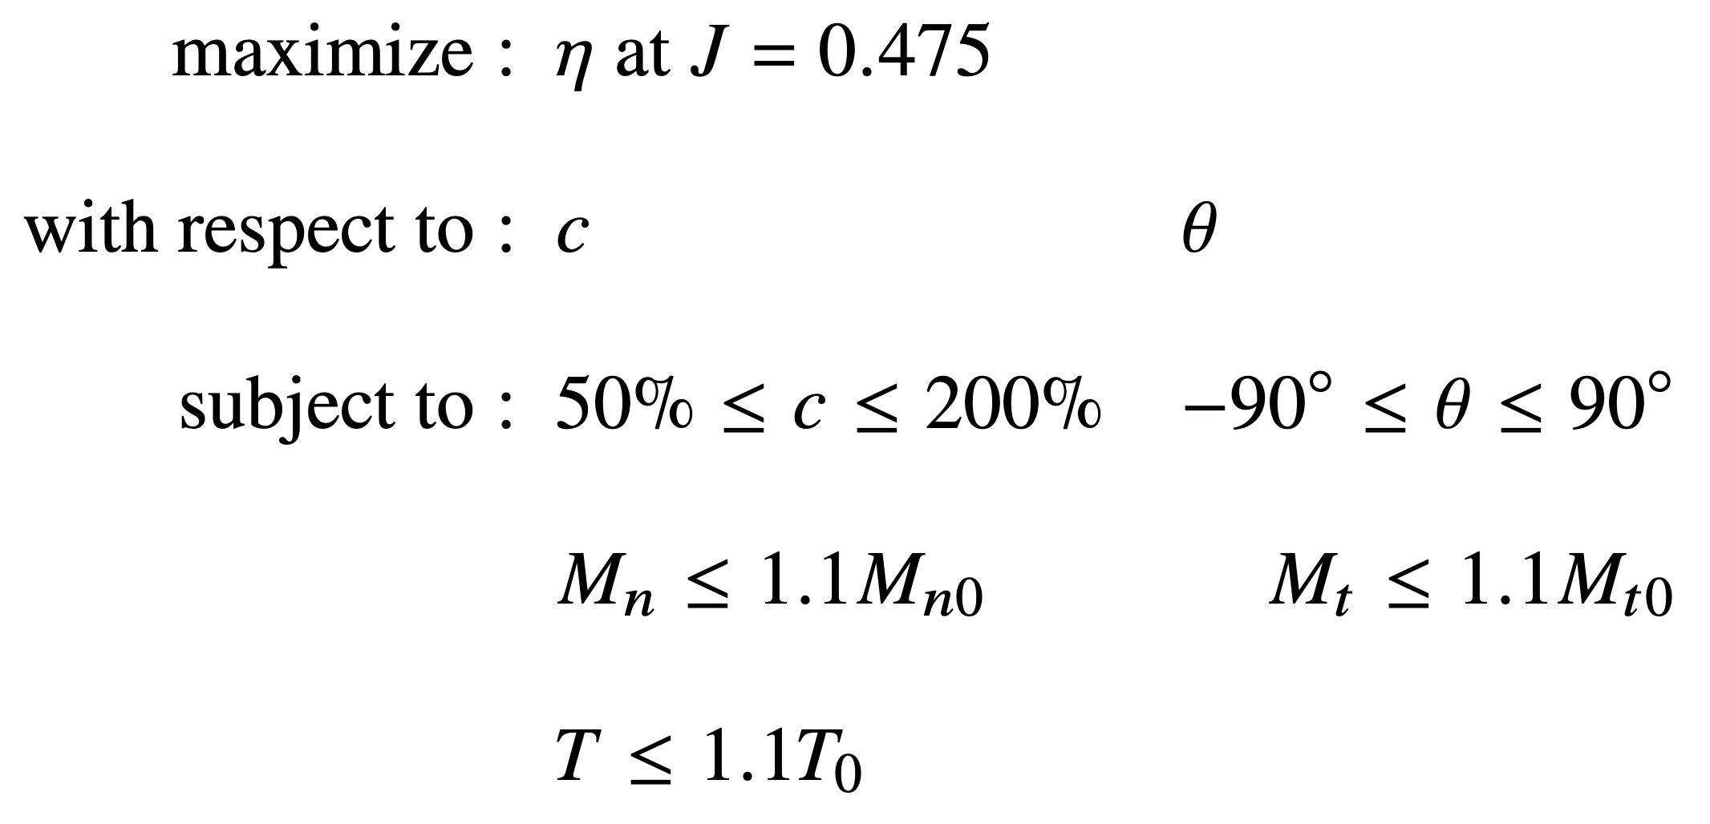
First Propeller Design

Slide 3
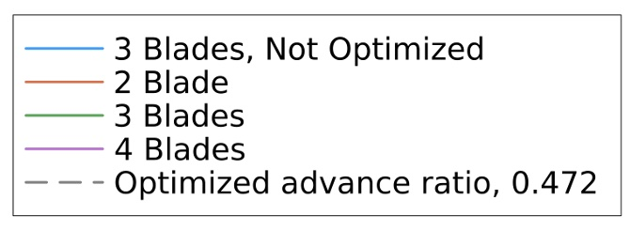
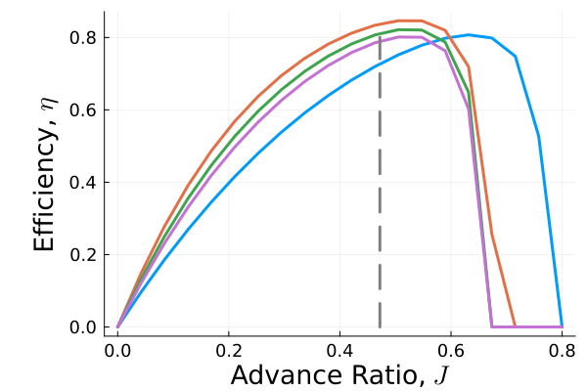
First Propeller Design

Slide 4
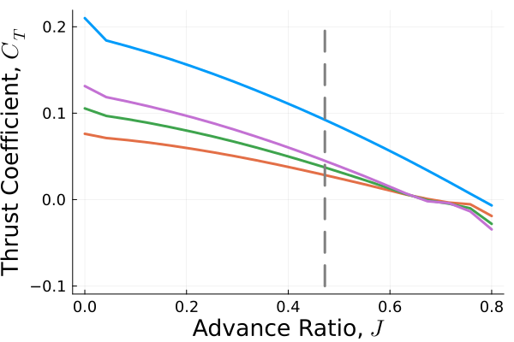

First Propeller Design

Slide 5

Problems

Slide 6

Problems

Slide 7
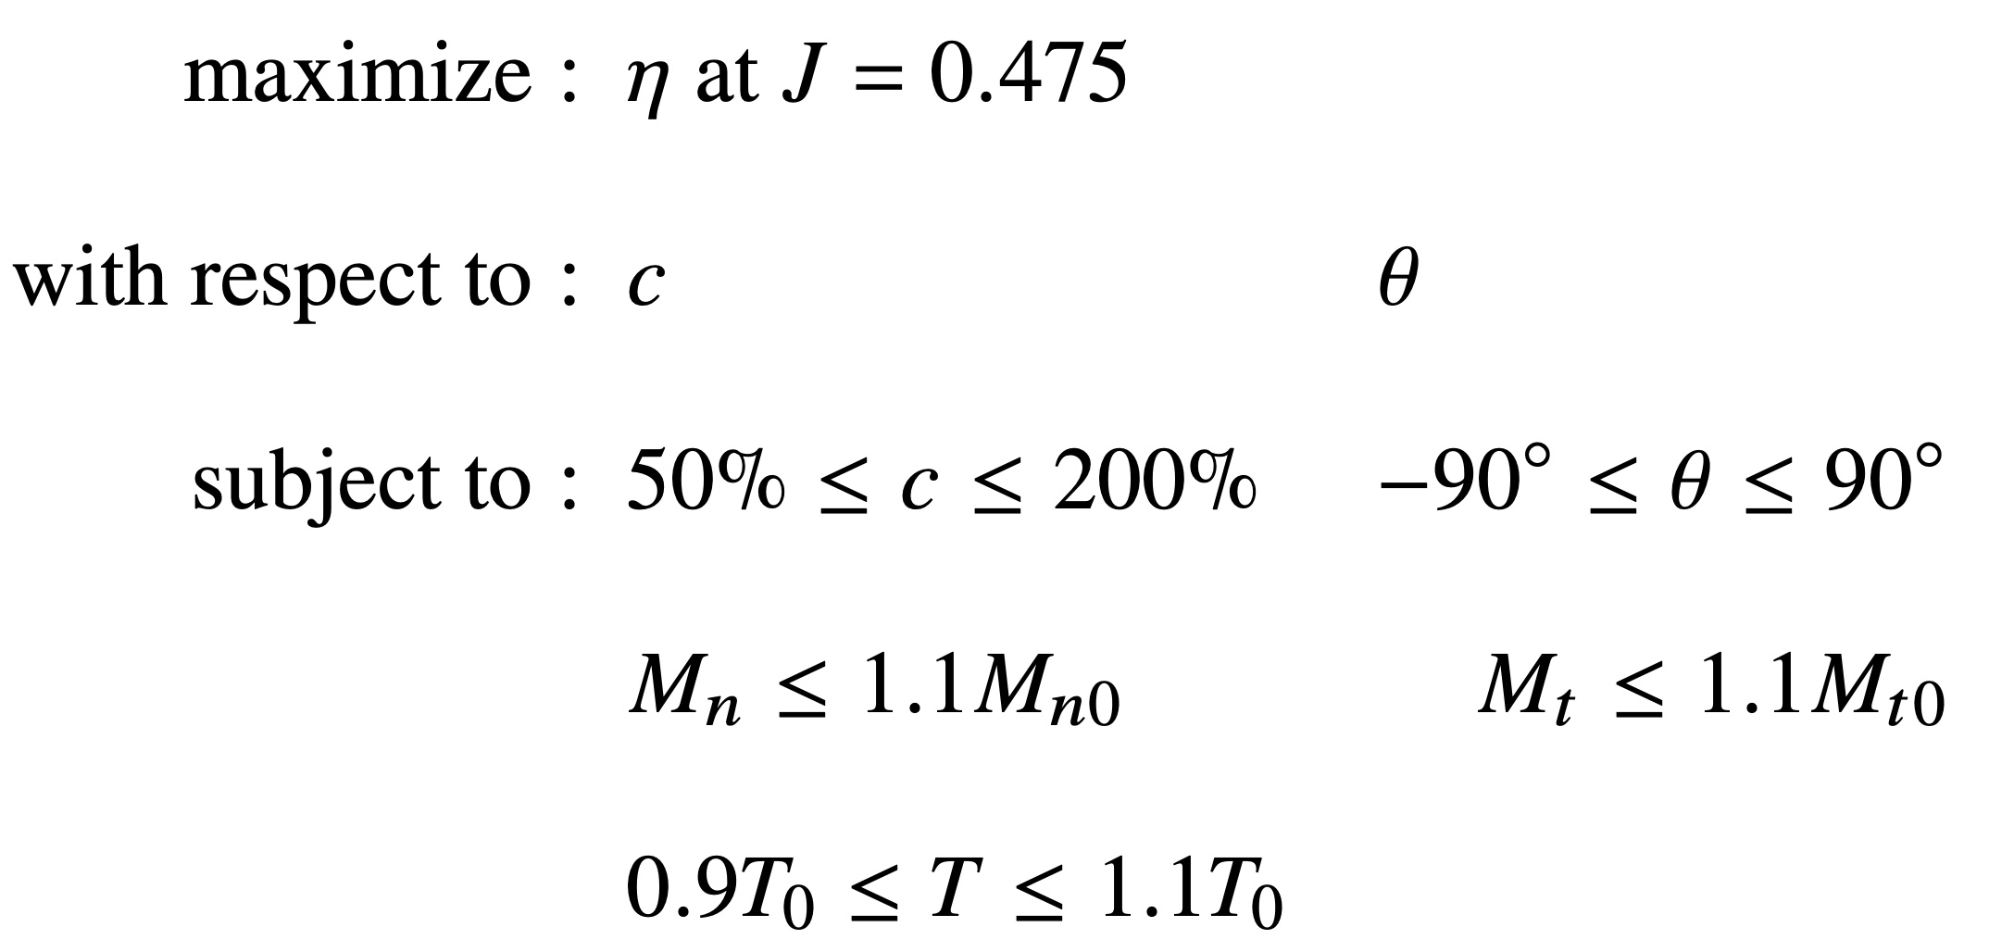
Second Propeller Design

Slide 8
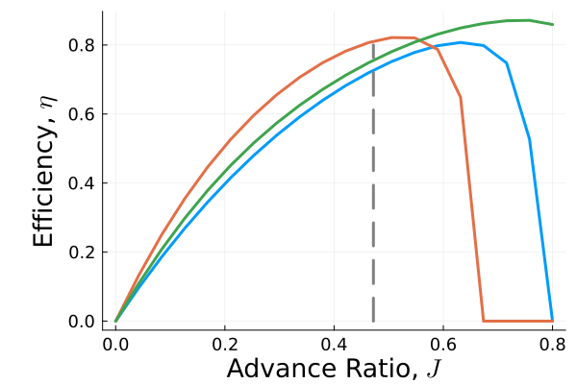

Second Propeller Design

Slide 9
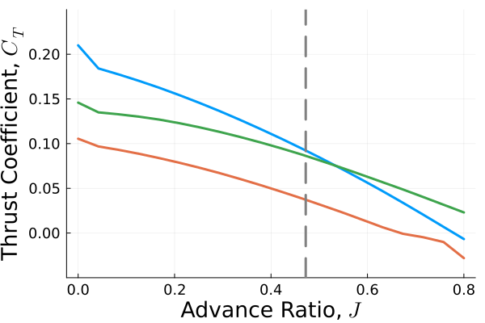

Second Propeller Design

